Slide 1



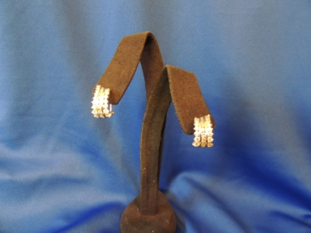
Live Auction
Begins at approximately 8:00 pm
Autographed Soccer Ball
Soccer ball signed by the 2012-1013 State Runner Up Champs
Donated by Saint Paul’s School
Parking Spot at Saint Paul’s for 2013-2014
Is your son late for school? Not a problem! His reserved parking
Spot is waiting!! For the entire school year, 2013-2014, your son
will have a designated parking spot OF YOUR CHOICE. Bid on
this excting auction item NOW!
Donated by Saint Paul’s School
Diamond Earrings
One pair of lady’s 14kt white gold three row diamond hoop earrings containing fifty-four round brilliant cut diamond melee’ weighing 2.17cts total weight.
Average color: H-I; Average Clarity: SI1-SI2
Donated by Boudreaux’s Jewelry

Slide 2
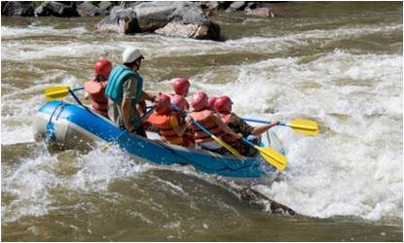
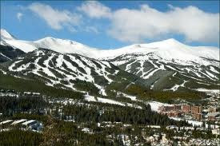
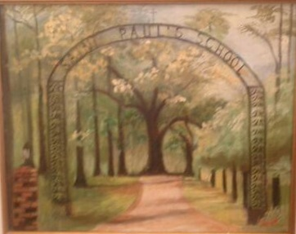

Live Auction
Breckenridge, Colorado
(summer and winter available)
Enjoy 7 nights at the Beaver Run Resort in Breckenridge. This condo unit features 4 bedroom and 4 baths, a full sized kitchen, dining and sitting area with fireplace and breathtaking views. Beaver Run Resort features several restaurants, deli, small grocery store, game room, tennis courts, workout room, indoor/outdoor pool with hot tubs, steam and sauna rooms plus a full spa. Ski in, ski out, ski storage and a full service ski shop for rentals on site. The summer season brings lush mountainsides covered with brilliant wildflowers, rivers and streams rushing with cool clear water and miles of trails to be explored. Summer activities include golf, mountain top super slide, fishing, biking, hiking, rafting and shopping. Black out dates: Easter Week 2013, Christmas through New Year 2013, Mardi Gras Week 2014.
Donated by Mr. & Mrs. Rick O’Krepki
Painting of Saint Paul’s Arch
Original painting of Saint Paul’s historic arch by
local artist Karen Foret.
Donated by Karen Foret
Drew Brees autographed Saints Helmet
Saints helmet autographed by record breaking
quarterback Drew Brees.
Donated by the New Orleans Saints

Slide 3





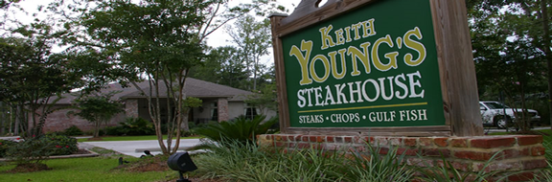
Live Auction
Pro Sports Fan
Getaway
Two lower level seats to a regular season Major League Baseball game, National Basketball Association game, National Football League game, or National Hockey League game or two grounds passes to a non-major Professional Golfers Association golf tournament. Included with the tickets is a two-night stay in a standard room, including breakfast for two, in deluxe accommodations such as the Hyatt, Marriott, Sheraton or Wyndham hotel. Round-trip coach class service for two to anywhere American Airlines flies in the forty-eight contiguous United States or Canada.
Airline exclusion dates may apply. Game must be on a Friday, Saturday or Sunday. Excludes U.S. PGA championship, Masters, U.S. Open, Ryder Cup and Presidents Cup.
Donated by Friends of Saint Paul’s
Dinner for Eight in the Wine Room of
Keith Young’s Steakhouse
Enjoy a fabulous five course meal at Keith Young’s Steakhouse in Madisonville. Enjoy the ambience of the Wine Room with a total of eight (8) guests enjoying wine and champagne with dinner. The Wine Room can be reserved Tuesday through Friday. No Saturday dinners. This offer expires on November 30, 2013.
Donated by a Keith Young’s Steakhouse

Slide 4
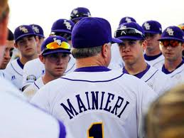



Live Auction
LSU Baseball Package
Game day tickets for four to the LSU-Southern Mississippi game held at Zephyr Field in New Orleans on April 3, 2013. Experience luxury while driving across the lake with George, in his private motor home, from Covington to the Tiger Tailgate party on game day. This package also includes a “meet and greet” with coach Paul Minieri and an autographed LSU helmet signed by coach Minieri too.
Donated by Dr. George Boudreaux ‘65
Seven Nights in Banff and Lake Louise
Enjoy four nights in a junior suite at the Fairmont
Resorts in Banff and Lake Louise, Alberta AND three
nights in a junior suite at the Fairmont Palliser in
Calgary, Alberta. Your stays includes a daily breakfast
for two. This trip includes round trip coach airfare for
two to Calgary, Canada.
Airline exclusion dates may apply.
Donated by A Friend of Saint Paul’s

